Slide 1



Small office, Home Offfice

Slide 2



Team Members
Ramani [CB.EN.U4CSE20107]
Parimarjan {CB.EN.U4CSE20147]
Jagadish [CB.EN.U4CSE20171]

Slide 3

Abstract
A company is fast-growing(scaling) it is intended to work separately from
HQ network.

Slide 4




Intentionally being a small network, here are the conditions
The aim of this project A company is fast-growing(scaling) it is intended to work separately from HQ network. using the software Cisco Packet Tracer with the implementation of wireless networking systems. This network consists of the following devices:
Aim
We used 1 router and 1 switch
3 departments(HR/FINANCE/IT) only as a small company cant manage much
Each dept. is in separate vlan
each dept has a wireless network for the users.
host devices obtain ipv4 automatically
all devices communicate with each other

Slide 5
Elements
ADMIN/IT DEPARTMENT FINANCER/HR DEPARTMENT CS/RECEPTION DEPARTMENT

Slide 6

Network Requirements
SOHO (SmallOffice HomeOffice)outline is considered for this wireless university network.
The network is divided into 3 areas :
ADMIN DEPT: it controls the whole part of the network and it constituents of a printer, access point, end system and few smart devices.
FINANCE DEPT: it controls financial part of the network.
CS/RECEPTION: it interacts with communication tasks.

Slide 7
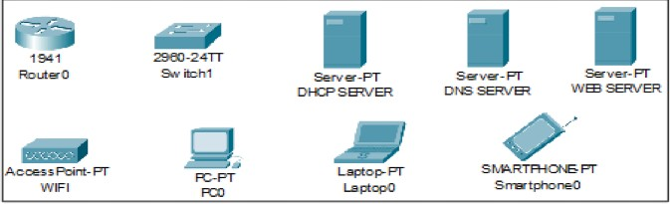
Devices Used In The Network
Devices
Laptop SmartPhone Tablet
AcessPoint Switch
Router Server
Coaxialcable
Coper-Straight
Type Of DEVICE
End Devices End Devices End Devices
network Devices[wirelesss] NetworkDevices
NetworkDevices NetworkDevices
Cables
Cables

Slide 8


ALL ELEMENTS

Slide 9

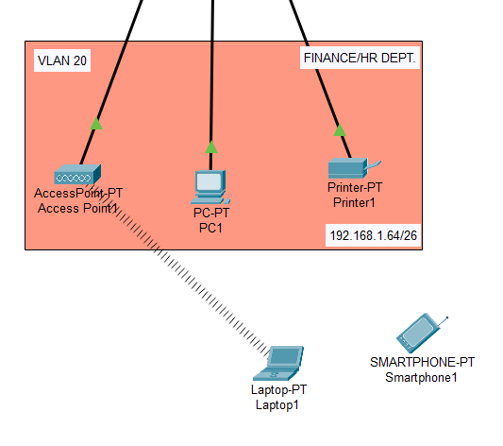
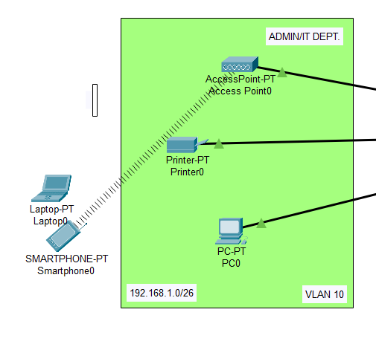
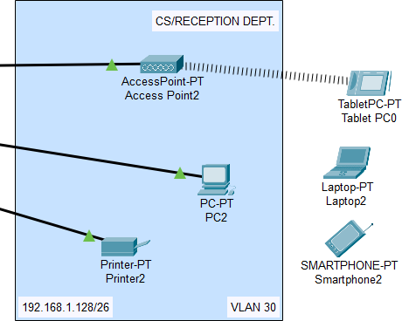

All three depts.

Slide 10
Securing Network:
Admin Dept : Admin@123 CS/Reception Dept: Customer@123 Finance Dept: Finance@123

Slide 11
Final Topology

Slide 12
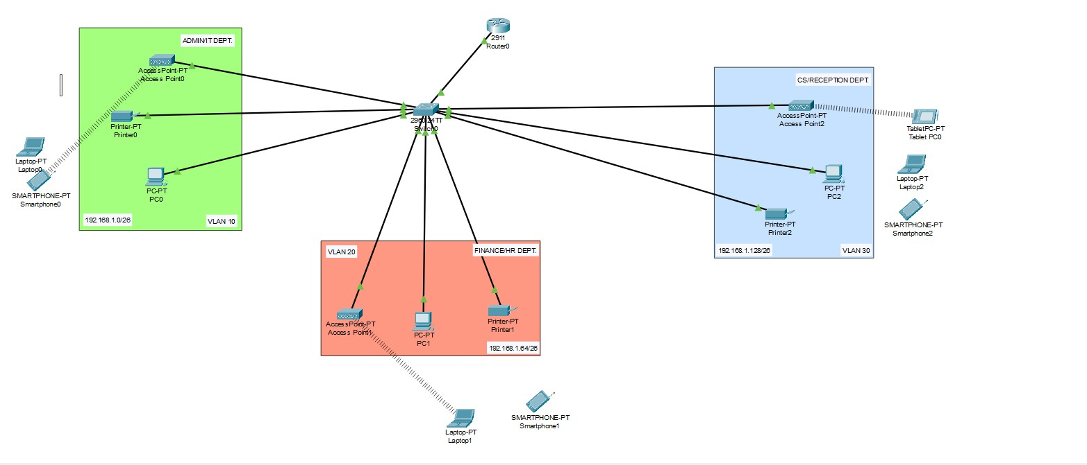

Slide 13
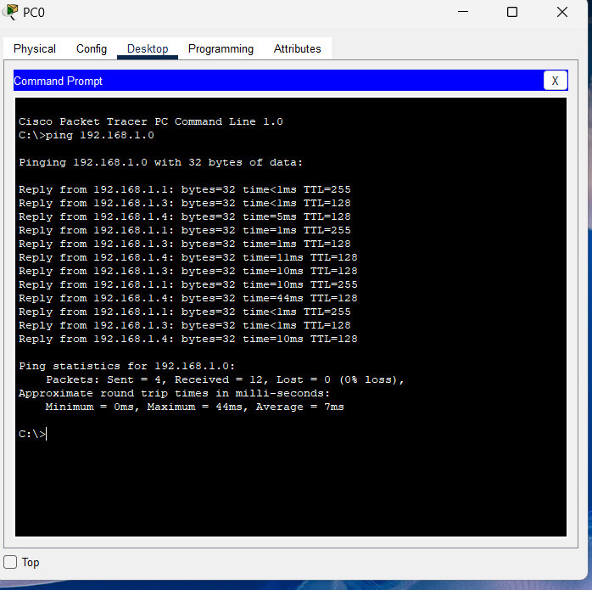
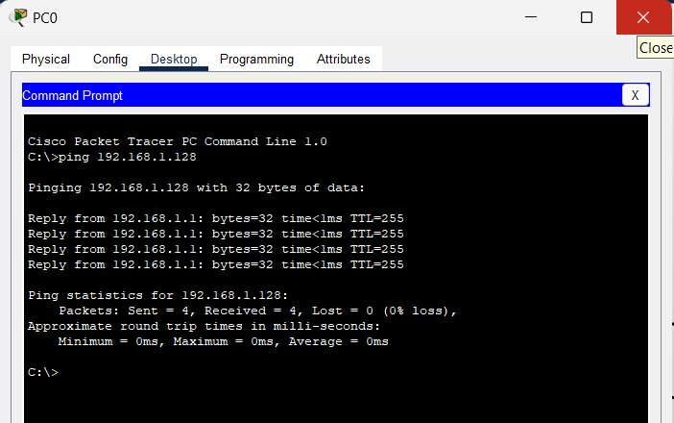
Ping Tests

Slide 14
Benfits

Slide 15
There are many benefits of small office home office. The one is the public gathering on roads and offices. When a person work from home he do not use vehicle that save the fuel and reduce pollution. The time wastage in the traveling from home to office is vanished. So the person can spent more time on the job and increase his income. You have more time to spend with your family when working from home. So you remain stress free with your family.
It is more comfortable to work from home than in a corporate office. You have no fix time to do fix tasks. You can spare time and also give extra time to your job. The resources for working can be chosen by you. I mean the make and model of devices like printer, computer, furniture etc. The best thing is that you are your own boss, you can take your own decision. Your health and living style can be improved by doing work from your home.

